Slide 1
Autonomous Vehicles: a survey to determine the comfort level and moral dilemma's that are involved
TJ Nagy & Chad-Michael Muirhead
November 29th , 2017

Slide 2
Objective
To see how people perceive self-driving vehicles
To see how moral decisions influence self-driving vehicles in an unpreventable accident
Develop a survey to retrieve this information from the public
Determine whether occupational status, gender or age influence decision

Slide 3
Methodology to Conduct Our Survey
Complete Human Subjects Research Training
Concise questions and dilemmas we seem fit for our survey
Create a consent form for the class to participate in the survey
Have class complete survey
Collected the class survey and used the information to gather and analyze data
Different measures were used to identify highest priority and different correlations in the surveys.
Put the class’s input into graphs and charts to see how people feel about self-driving vehicles

Slide 4
Results

Slide 6
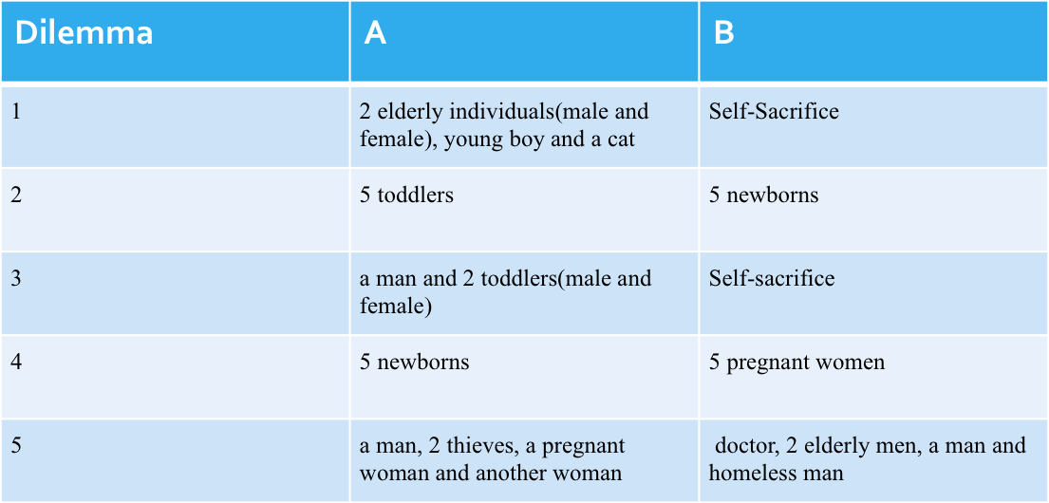
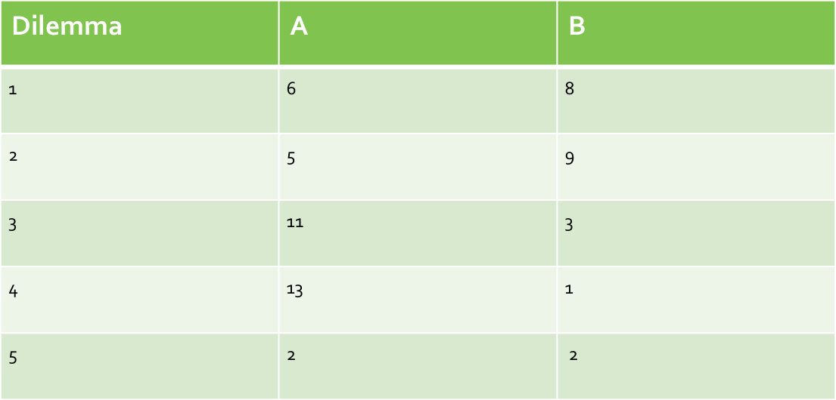
Based on the results from the survey completed by the participants in the study it was determined that different factors may affect choice in an unavoidable accident in an AV.
Age is one of the major factors with highest priority based on answers from the dilemmas, however this can change if an occupational status provides much value to society.
D3 proved that protecting oneself is of the highest preference.
D2 and D4 showed preference with age.
Gender had little impact.
Notes:
Based on this dilemma, it could be assumed that an unborn or pregnant woman should receive the highest priority in any unavoidable accident scenario.

Slide 7
Summary
Majority of participants believe autonomous vehicles will benefit society
Self-sacrifice is the least accepted choice in any unavoidable accident
Decisions autonomous vehicles make in the case of unavoidable accidents acceptance will vary based on different factors
Age appears to be of the highest priority if occupational status does not bring societal value.
Gender is of the least priority in the study

Slide 8
Summary/Conclusion
Limitations include :
Class size sample limited to participants in class
Majority of males participated in survey
Difficult to determine correlation and causation
Lack of diversity in participations thus does not mimic real life preference
Improvements:
More diverse group of participants which effectively models society
More occupational jobs in dilemmas to assist in measuring their value or priority level based on selections.

